Slide 1

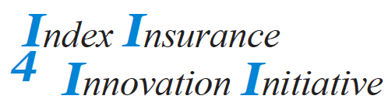
Training and Education of Purchasers
Insights and Challenges from IBLI in East Africa
Andrew Mude
and Chris Barrett
I4 Technical Meeting
13-14 May 2011
Washington, DC

Slide 2
What Are We Educating About?
Objective:
  Ensure clients understand the IBLI product and coverage features enough to allow them to make informed purchasing decisions.
Set aside the Response Function and focus on the Index:
We counter our underemphasis on the technical mechanics of the response function by placing an emphasis on basis risk. The Response Function is complex. But because the Index (predicted livestock mortality) is in easily understandable units of the insurable risk it is easier to explain.
DATA
Livestock Mortality
Response Function
Index
Predicted Livestock Mortality
NDVI

Slide 3
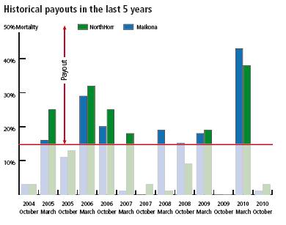
Key IBLI Extension Messages
Level of Risk Coverage
Basis risk
  Index is area-average
  predicted livestock mortality
  Payment on area-specific index
Premiums
Temporal and Spatial Coverage

Slide 4
Awareness and Uptake
Heard of IBLI ?
Yes: 723
Bought IBLI?
No: 201
Yes: 255
No: 468
Sources of Knowledge (Among Purchasers)

Slide 5
Degree of Knowledge (Among those who know)
Tested statistical independence of distributions producing the pattern of responses.
Compared Purchased versus Not Purchased: Only distributions highlighted in yellow (next page) not statistically independent.
Compared three source of knowledge distributions against each other. Distributions statistically independent for all responses.
Based on your understanding of IBLI, how often do you have to pay a premium in order to remain insured. | Did not Purchase IBLI | Purchased IBLI |  | ILRI Game/Survey Most Important Info Source | VIP most Important Info Source | Other info source most important
once every 6 months | 14.72 | 18.9 |  | 15.57 | 20.72 | 11.71
once every year | 42.21 | 51.57 |  | 51.23 | 41.83 | 43.24
once every 2 years | 0.65 | 1.18 |  | 0 | 1.2 | 1.35
till compensation has been paid | 0.87 | 2.36 |  | 2.05 | 1.59 | 0.45
dont know | 41.56 | 25.98 |  | 31.15 | 34.66 | 43.24
If you do not receive indemnity payout (compensation) from the livestock insurance, would you expect to receive your premium back? | Did not Purchase IBLI | Purchased IBLI |  | ILRI Game/Survey Most Important Info Source | VIP most Important Info Source | Other info source most important
yes | 48.26 | 32.54 |  | 37.04 | 35.48 | 56.76
No | 51.74 | 67.46 |  | 62.96 | 64.52 | 43.24

Slide 6
Degree of Knowledge (Among those who know)
Based on your understanding of IBLI, what does indemnity payout demand on? | Did not Purchase IBLI | Purchased IBLI |  | ILRI Game/Survey Most Important Info Source | VIP most Important Info Source | Other info source most important
- the number of livestock you have lost | 3.25 | 2.78 |  | 3.28 | 3.61 | 2.26
- predicted number of livestock lost due to poor forage condition close to your home base camp | 8.46 | 11.9 |  | 7.38 | 10.84 | 10.86
- predicted number of livestock lost due to poor forage condition averaged over the normal grazing areas of community | 54.23 | 57.94 |  | 62.3 | 57.43 | 45.7
- don't know | 34.06 | 27.38 |  | 27.05 | 28.11 | 41.18
Based on your understanding of IBLI, when do you expect an indemnity payout? | Did not Purchase IBLI | Purchased IBLI |  | ILRI Game/Survey Most Important Info Source | VIP most Important Info Source | Other info source most important
anytime livestock are lost causing the household to suffer | 0.86 | 1.18 |  | 0.82 | 1.2 | 0.9
at the end of each rainy season | 1.3 | 1.57 |  | 2.04 | 1.2 | 0.9
at the end of each rainy season when rain fails | 3.67 | 5.12 |  | 2.86 | 4.78 | 4.95
at the end of each dry season | 7.56 | 11.81 |  | 13.06 | 7.17 | 6.76
at the end of each dry season when forage conditions are worse than normal | 25.7 | 29.92 |  | 25.71 | 26.69 | 29.28
at the end of each dry season when forage conditions are much worse than normal | 33.69 | 37.8 |  | 33.88 | 44.62 | 25.68
dont know | 27.21 | 12.6 |  | 21.63 | 14.34 | 31.53

Slide 7
What we are learning
A considerable lack of understanding amongst a good portion of those who purchased
  So why do they purchase?
  What are the implications of this misinformed demand?
Nevertheless, those who purchase are significantly more likely to understand key features of the product.
  Improve on extension messaging and targeting?
  Need further analysis on relationship between understanding and other key covariates.
Relative to more costly games, VIPs doing well.
Communication needs to be about index variable, not input.

Slide 8
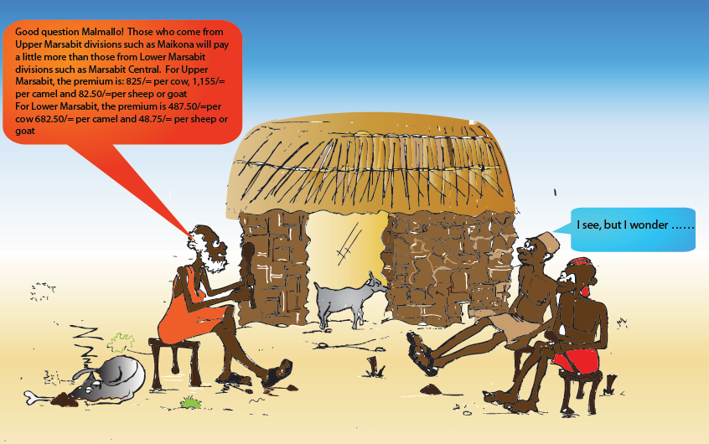
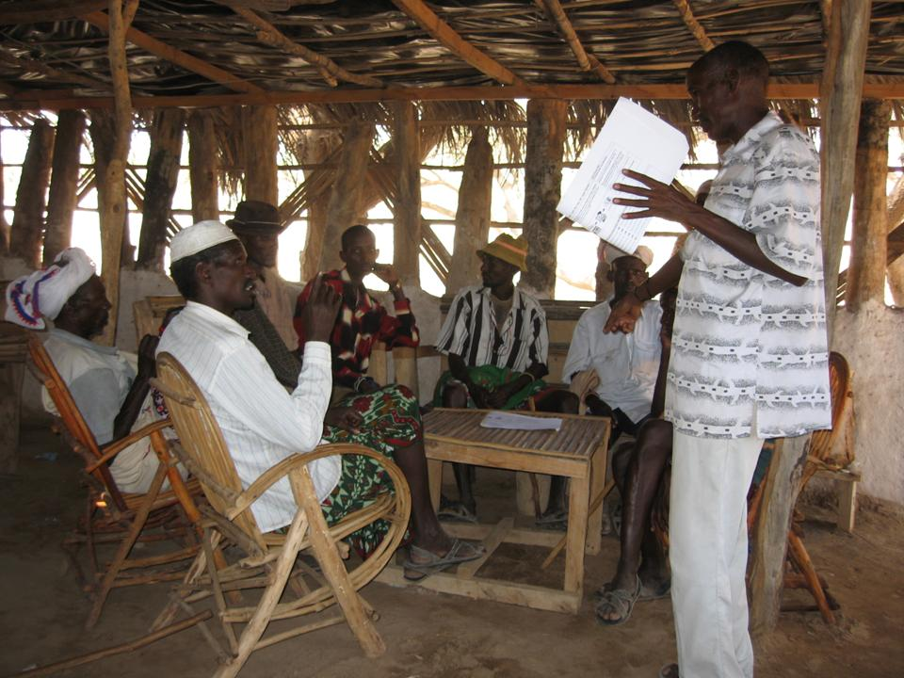
Year 2 of IBLI: Improving the Extension Toolkit
Developing a systematic training manual with a clear guided curriculum, targeted applications and teaching aides.
  Particularly important for standardizing message and setting the stage for full commercial transition.
Improved VIP selection and incentives.
VIPs equipped with quick reference manual and comic strip to facilitate easy engagement.
Radio Messaging

Slide 9
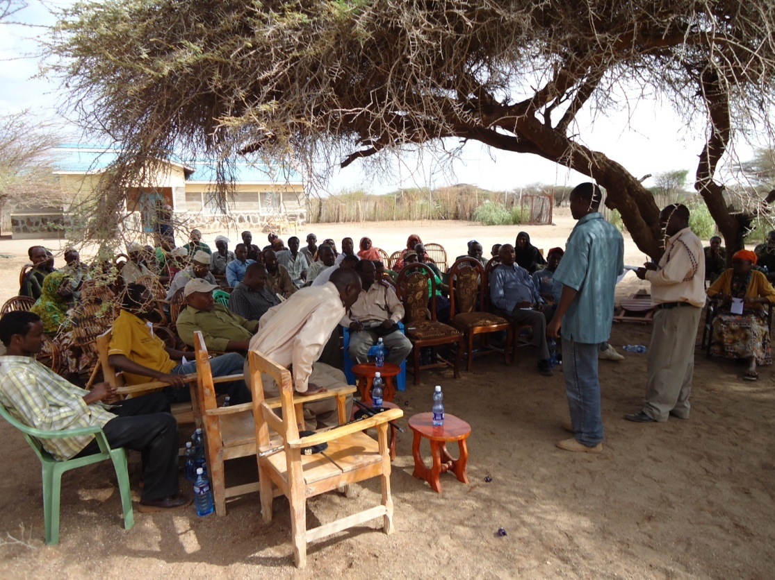

Expanding into Ethiopia: Cross-border exchange
Delegation of key stakeholders from Borena I4 project brought to Northern Kenya for peer-to-peer learning in multiple sites.

Slide 10

Thank you and stay tuned!
For more information please visit:
www.ilri.org/ibli/
Or watch,
http://blip.tv/file/3757148
Notes:
10

